Slide 1
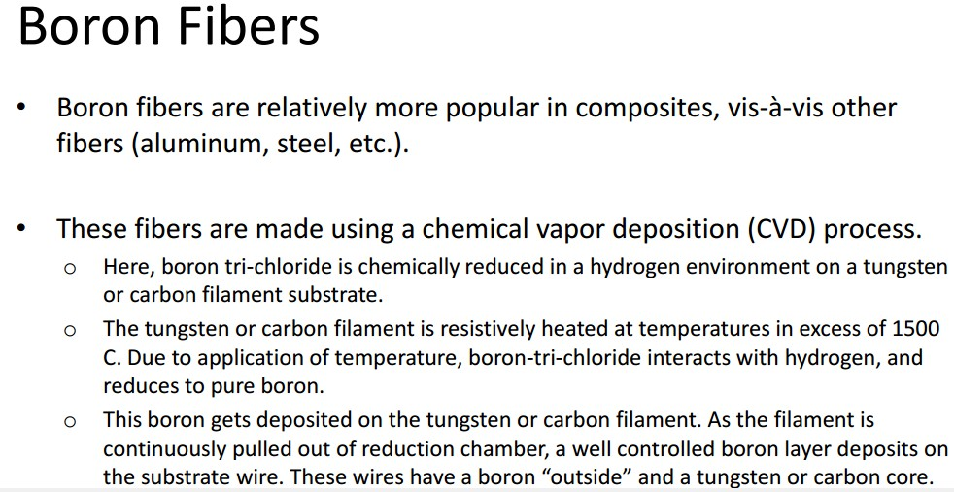

Assist.Prof.Dr. Dhia ahmed

Slide 2
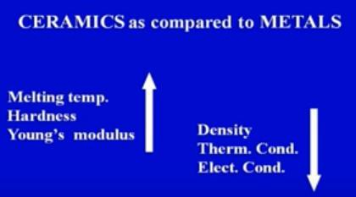
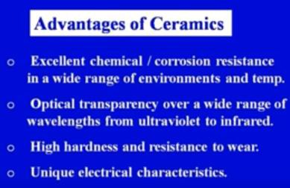
Assist.Prof.Dr. Dhia ahmed
Ceramics

Slide 3
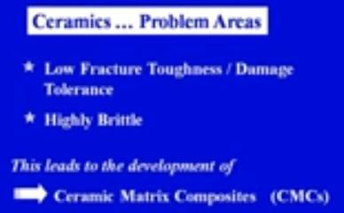
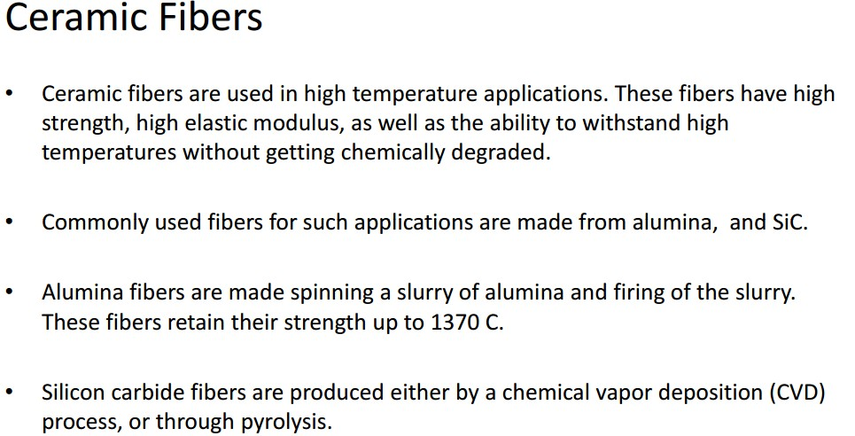
Assist.Prof.Dr. Dhia ahmed

Slide 4

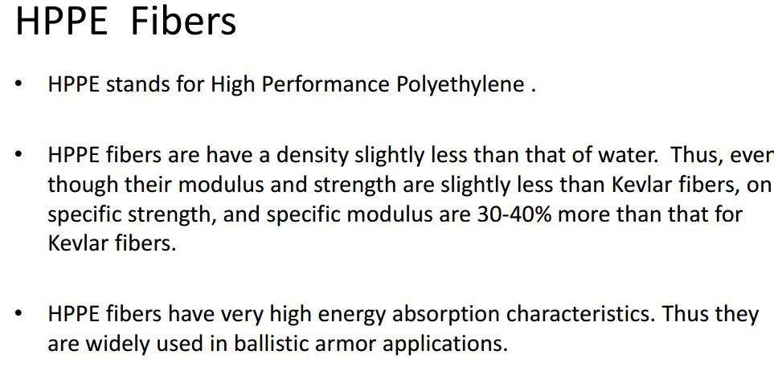

Assist.Prof.Dr. Dhia ahmed

